Slide 1
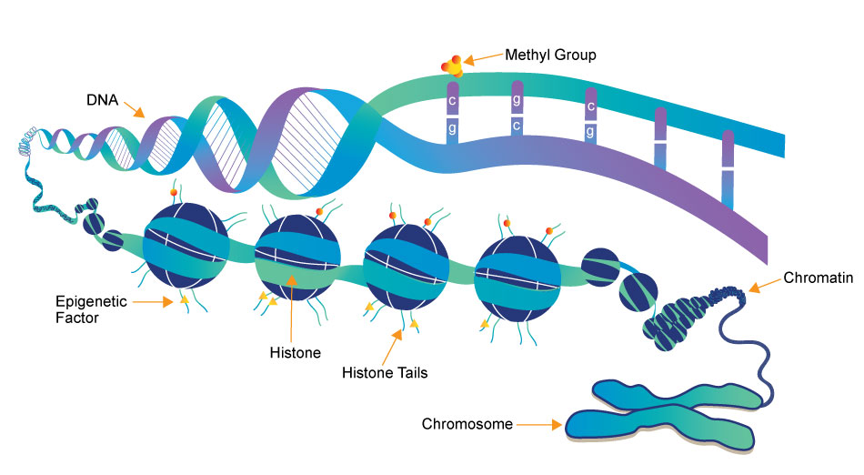
Epigenetics
ATHBY Human Biology

Slide 3
Review
Explain why messenger RNA is needed for protein synthesis (4 marks)
Draw the sliding filament model of muscle (6 marks)
Describe the three stages of cellular respiration (9 marks)

Slide 4
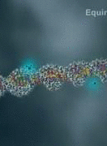
Learning Intentions
Epigenetics is the study of phenotypic expression of genes, which depends on the factors controlling transcription and translation during protein synthesis, the products of other genes, and the environment.

Slide 5
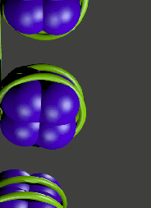
Success criteria
Define epigenetics.
Define the epigenome.
Describe the structure of chromatin.
List and describe four mechanisms of epigenetics (histone modification, acetylation, histone methylation and DNA methylation).
Classify epigenetic modifications as enhancers or inhibitors.
List environmental factors that influence epigenetics.

Slide 6
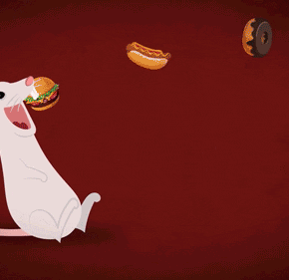
Epigenetics
“In addition to” or “on top of” genetics, epigenetics refers to changes in gene expression that are independent of the genes themselves.
Epigenetics allows for environmental factors to be inherited, by influencing which genes are switched on or off in successive generations.

Slide 7
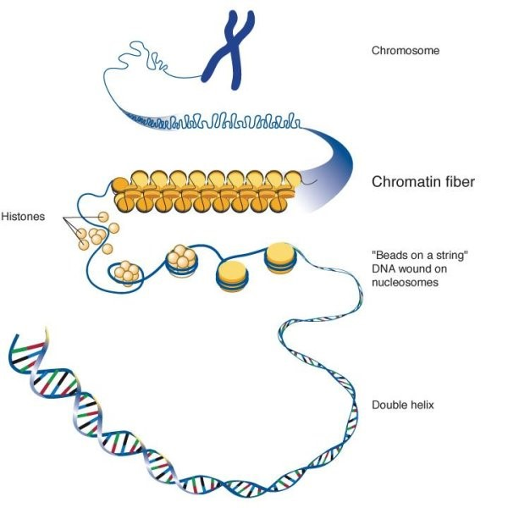
The epigenome
The genome is the hereditary information encoded in a person’s DNA, but the epigenome is the sum of all factors which control gene expression, so controls when and which cells produce which proteins.

Slide 9
Chromatin
Chromatin fibres are strands of DNA, coiled around special proteins called histones. Histones influence the way that genes are expressed, for example once a stem cell differentiates into a liver cell, it will produce more liver cells, rather than reverting back into a stem cell.

Slide 10
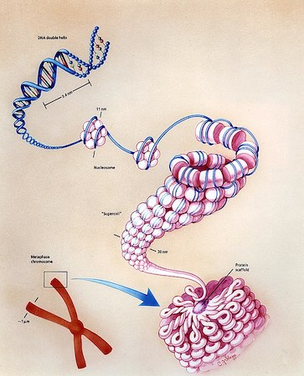

Slide 11
Changes to histone shape
As histones are proteins, their shape can be modified by changing the amino acid sequence. These changes will be copied into new histone molecules each time new DNA molecules are produced.

Slide 12
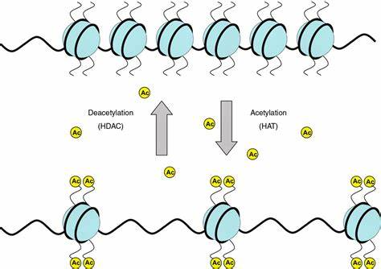
Acetylation
A histone can also be modified by addition of the acetyl group (CH₃CO), which relaxes the chromatin, promoting transcription and therefore enhancing gene expression.

Slide 14
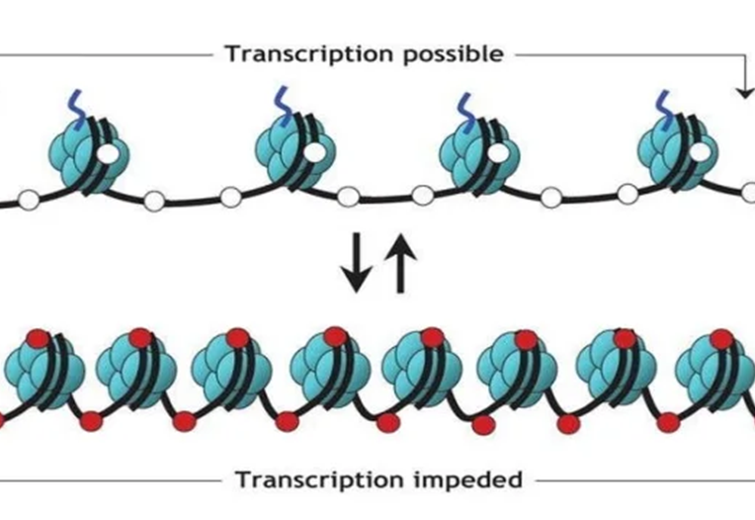
Methylation
Chromatin can be modified by addition of methyl groups (CH₃) to either the histone or the DNA molecule.

Slide 15
Methylation
Histone methylation may either increase or decrease transcription, depending on where it attaches.

Slide 16
Methylation
DNA methylation usually occurs only where a cytosine nucleotide is next to a guanine nucleotide. It will always inhibit gene expression by restricting access of RNA polymerase to the DNA molecule.

Slide 17
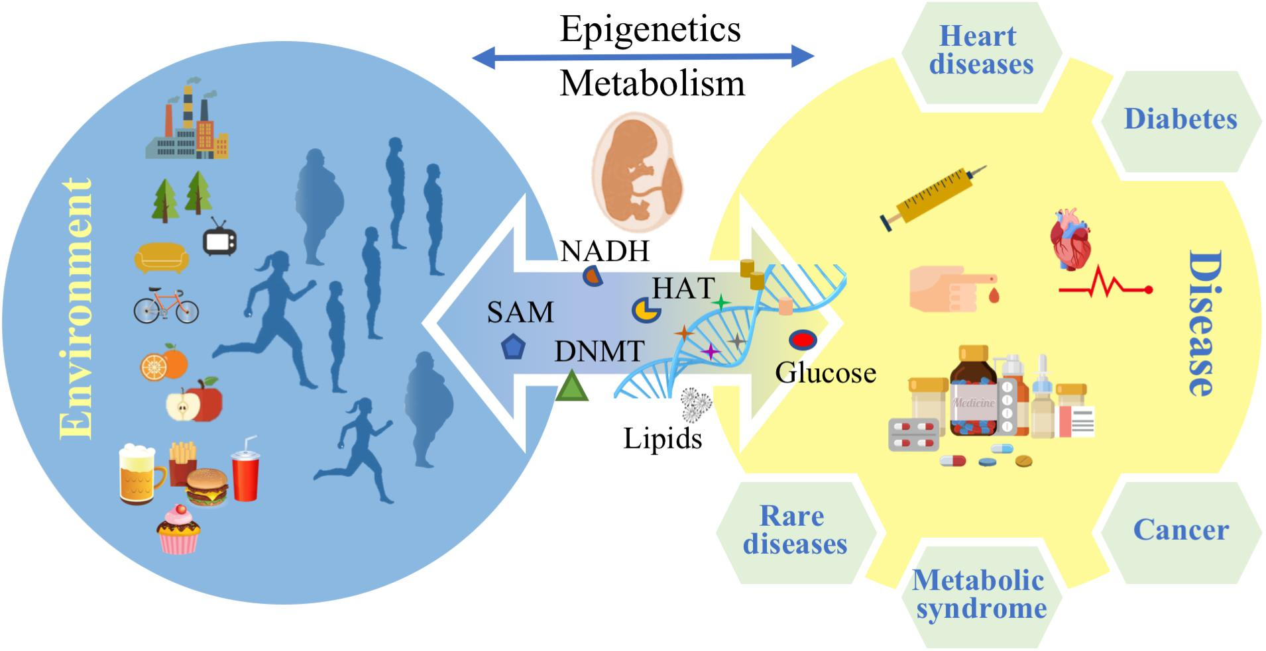
Exposure to environmental stimuli such as severe stress, nutritional factors, toxins or drugs have been identified as epigenetic factors that can influence gene expression at any step in the pathway from gene to protein.

Slide 19
Success criteria
Define epigenetics.
Define the epigenome.
Describe the structure of chromatin.
List and describe four mechanisms of epigenetics (histone modification, acetylation, histone methylation and DNA methylation).
Classify epigenetic modifications as enhancers or inhibitors.
List environmental factors that influence epigenetics.

